Slide 1
Google Play Store Apps

Slide 2
About the Dataset
Each row represents an app on the Google Play Store
Columns represent statistics for each app
Motivation
Identify the most common type of content in the store
Identify the most common ratings
Identify correlations between rating and number of reviews
Understand the relationship between price and rating
Identify if ratings are significantly different for apps that are free vs paid

Slide 3
Variables in Analysis
Content Rating
Categorial: Everyone 10+, Teen, etc.
Category
Categorial: Game, Business, etc.
Rating
Quantitative: Between 1 and 5
Reviews
Quantitative
Price
Quantitative
Type
Categorial: Free vs Paid

Slide 4
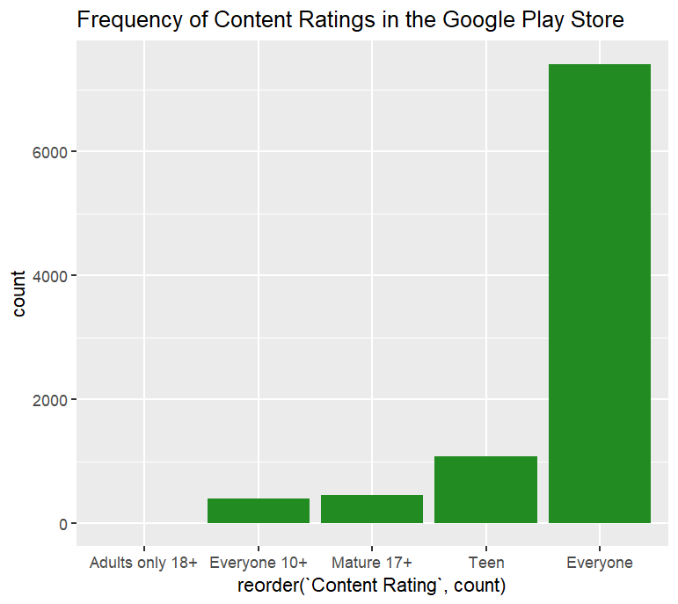
The Most Common Content Rating
Most common to least common:
Everyone
Teen
Mature 17+
Everyone 10+
Adults only 18+

Slide 5
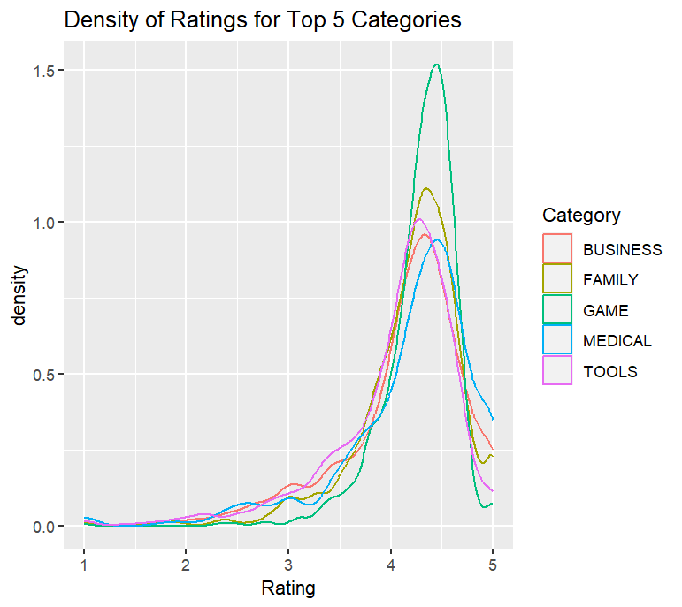
Density of Ratings for Top 5 Categories
Normal Distribution skewed to the right
Median Rating likely to fall under a rating of 4
Game category most frequently scored high

Slide 6
Correlation test between Rating and Reviews
Pearson Correlation
P-value = 4.073e-11
95% confidence Interval (0.0479, 0.0883)
Coefficient = 0.0681
Spearman Correlation
P-value < 2.2e-16
Coefficient = 0.1565

Slide 7
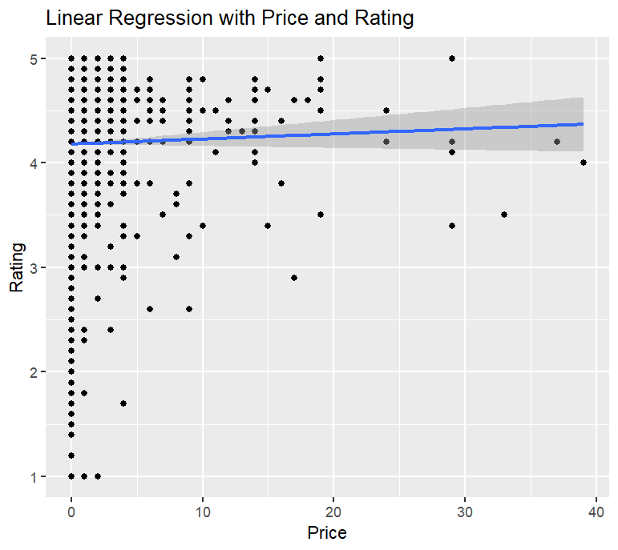
Linear Regression with Price and Rating
R-squared = 0.000261
Residual error = 0.5444
P-value = 0.1582
Slope = 0.00486

Slide 8
T-Test for Type and Rating
Type (independent) = Free or Paid
Rating (dependent)
P-value = 0.00008702
95% Confidence Interval = (-0.147, -0.049)
Means
Free = 4.173
Paid = 4.271
The true difference in means is not zero

